Slide 1

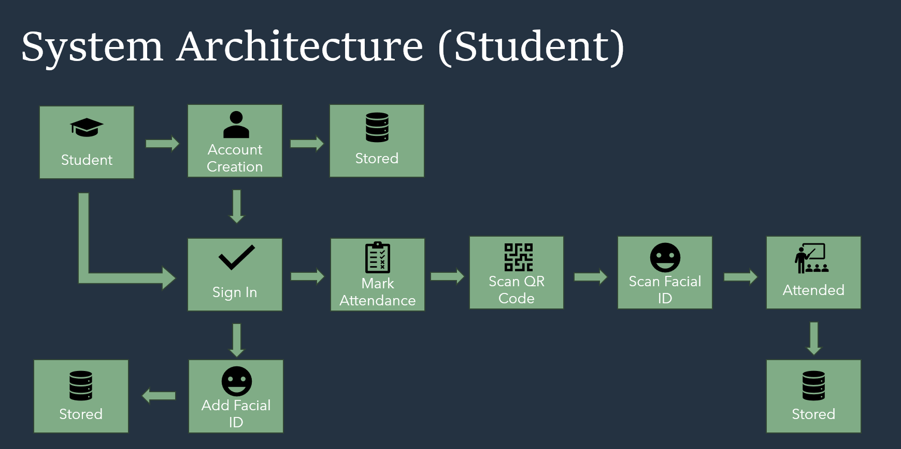

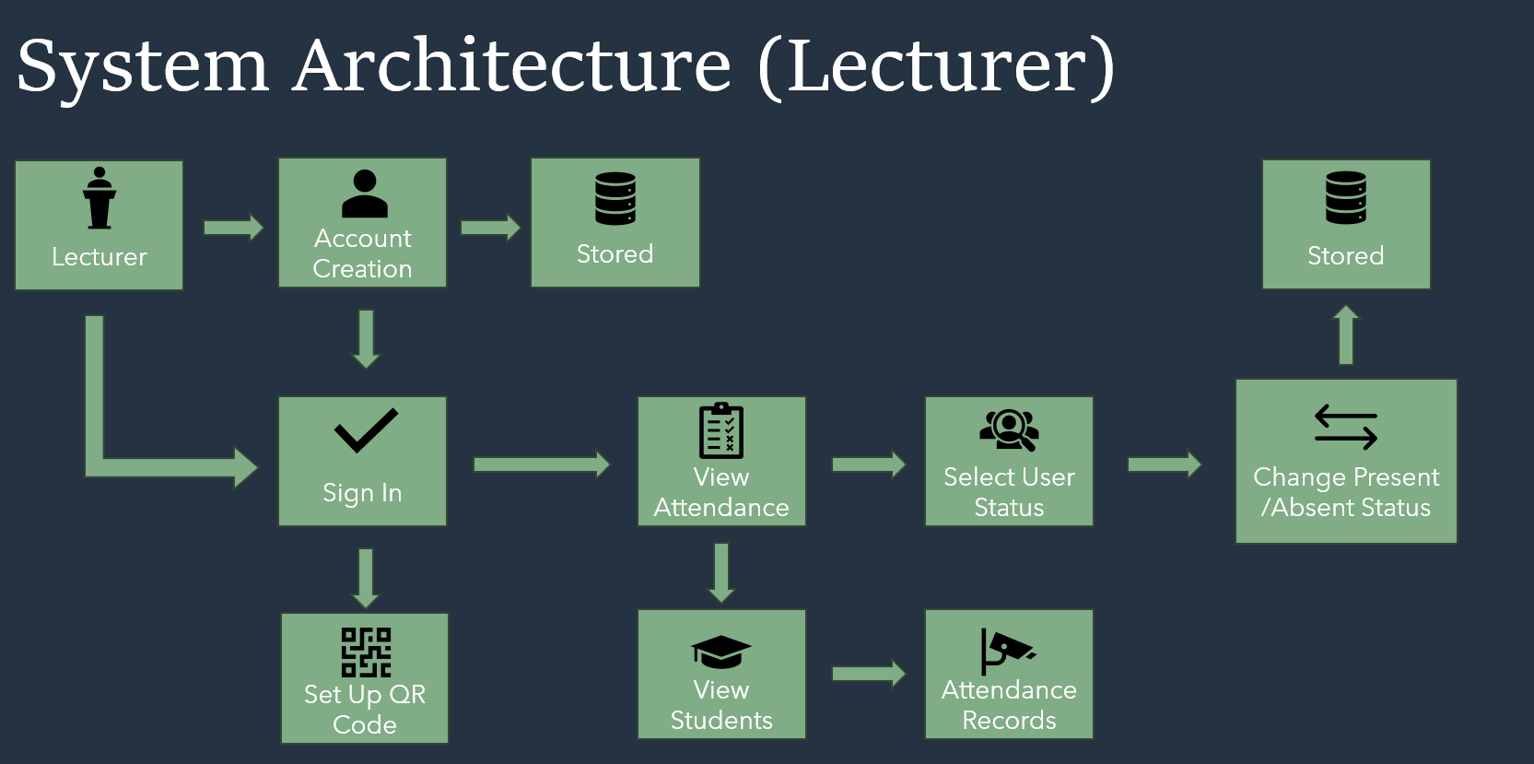

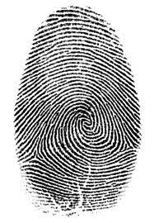







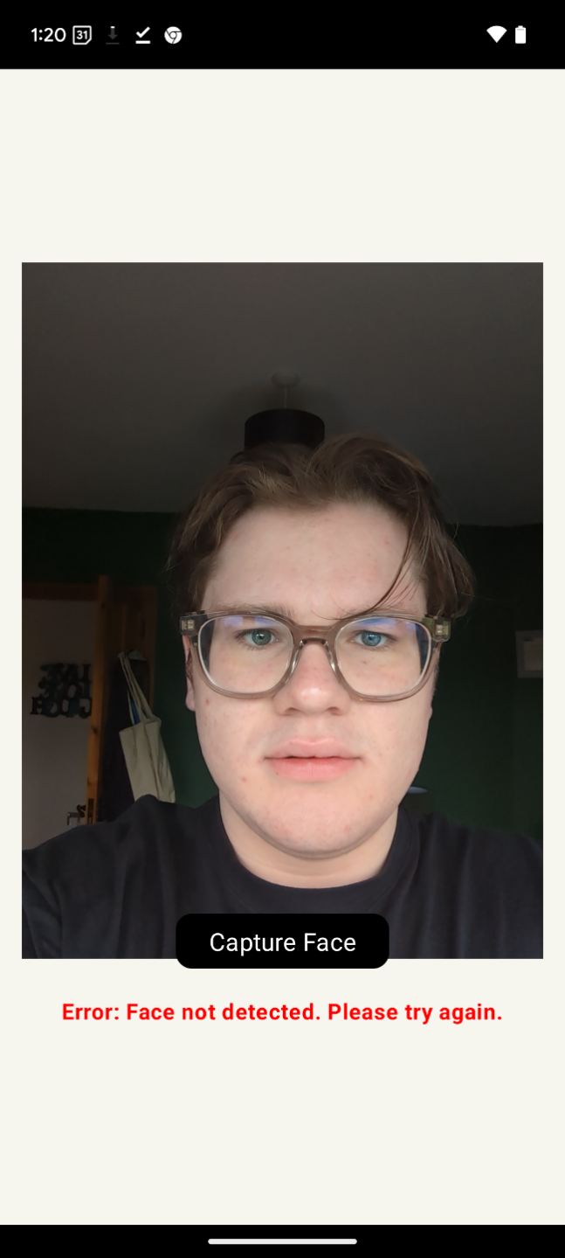
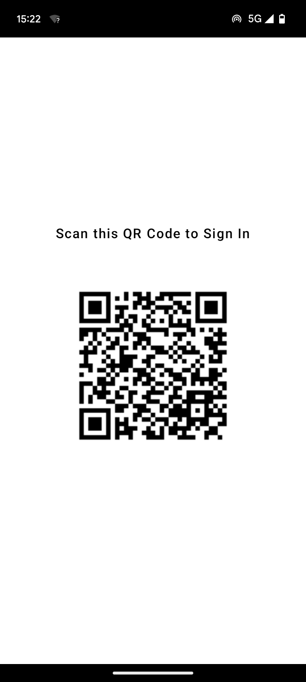
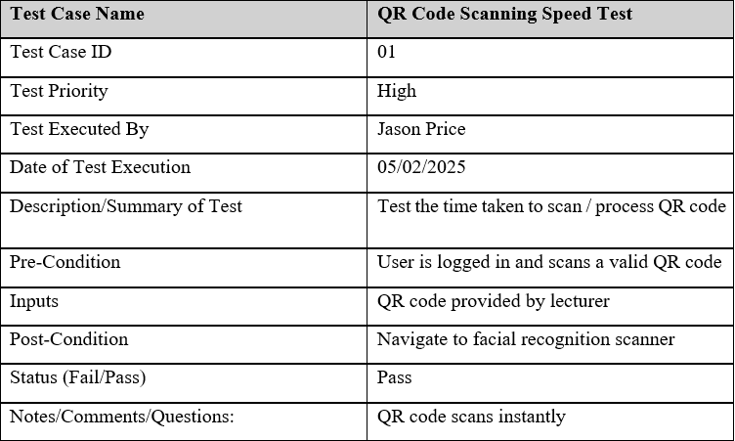
Facial Identification with QR Code Scanning Attendance
BSc Honours in Internet Systems Development
Introduction
Architecture Overview
Future Considerations
Traditional attendance taking systems such as paper and online tracking are prone to errors. StudentSignIn revolutionizes that with QR codes and face recognition. It uses Firebase for real-time authentication, face detection with Google ML Kit, and a QR scanner. This automation removes errors and proxies and gives lecturers instant real-time access to information.
Future versions of StudentSignIn can leverage OpenCV for enhanced face recognition accuracy. Fingerprint scanning could also benefit students for students who disagree with the use of facial recognition. The attendance data could also be used to a better degree to further provide lecturers with valuable insights into their students and how they are doing within modules. These iterations will ensure StudentSign thrives within the attendance market.
Goals
Develop a QR code and face recognition attendance system for student authentication.
Automate attendance and save records in Firebase for easy access by lecturers.
Give lecturers up-to-date attendance information for monitoring.
Use Google ML Kit for face detection and use Firebase for authentication of users.
Eliminate administrative burdens to free up students' lives.
Technologies
Logo
Results
The StudentSignIn system employed face recognition and QR codes to prevent false sign ins. In bright light, face detection functioned well. The QR codes functioned exceptionally well. All attendance data was stored in Firebase correctly. The average sign-in took 15 seconds to a high degree of success. StudentSignIn was a simple but effective attendance solution capable of holding a large amount of student data.
Testing
The StudentSignIn application was tested exhaustively for usability, security, and performance. The most prominent tests were the face recognition and QR code verification for the students already registered. It updated attendance in real time in Firebase for the convenience of lecturers. The performance tests revealed a steady. The tests in general assured StudentSignIn of its efficiency, reliability and fraud prevention.
Mobile Application
Conclusion
StudentSignIn enhances attendance with face and QR scans. With Firebase for real-time data and Google ML Kit for authentication, it discourages manipulating attendance, increases accuracy and saves time for lecturers. This project illustrates the scalability of biometric authentication. Other future possibilities are attendance analytics and fingerprint authentication and integration with college systems to improve tracking.

